Slide 1



StyLEFORMER A Convolution-Free Style Image Generator
based on Transformer And Stylegan2.
Sapienza
University of Rome
Fabio Caputo
Weihao Peng

Slide 2
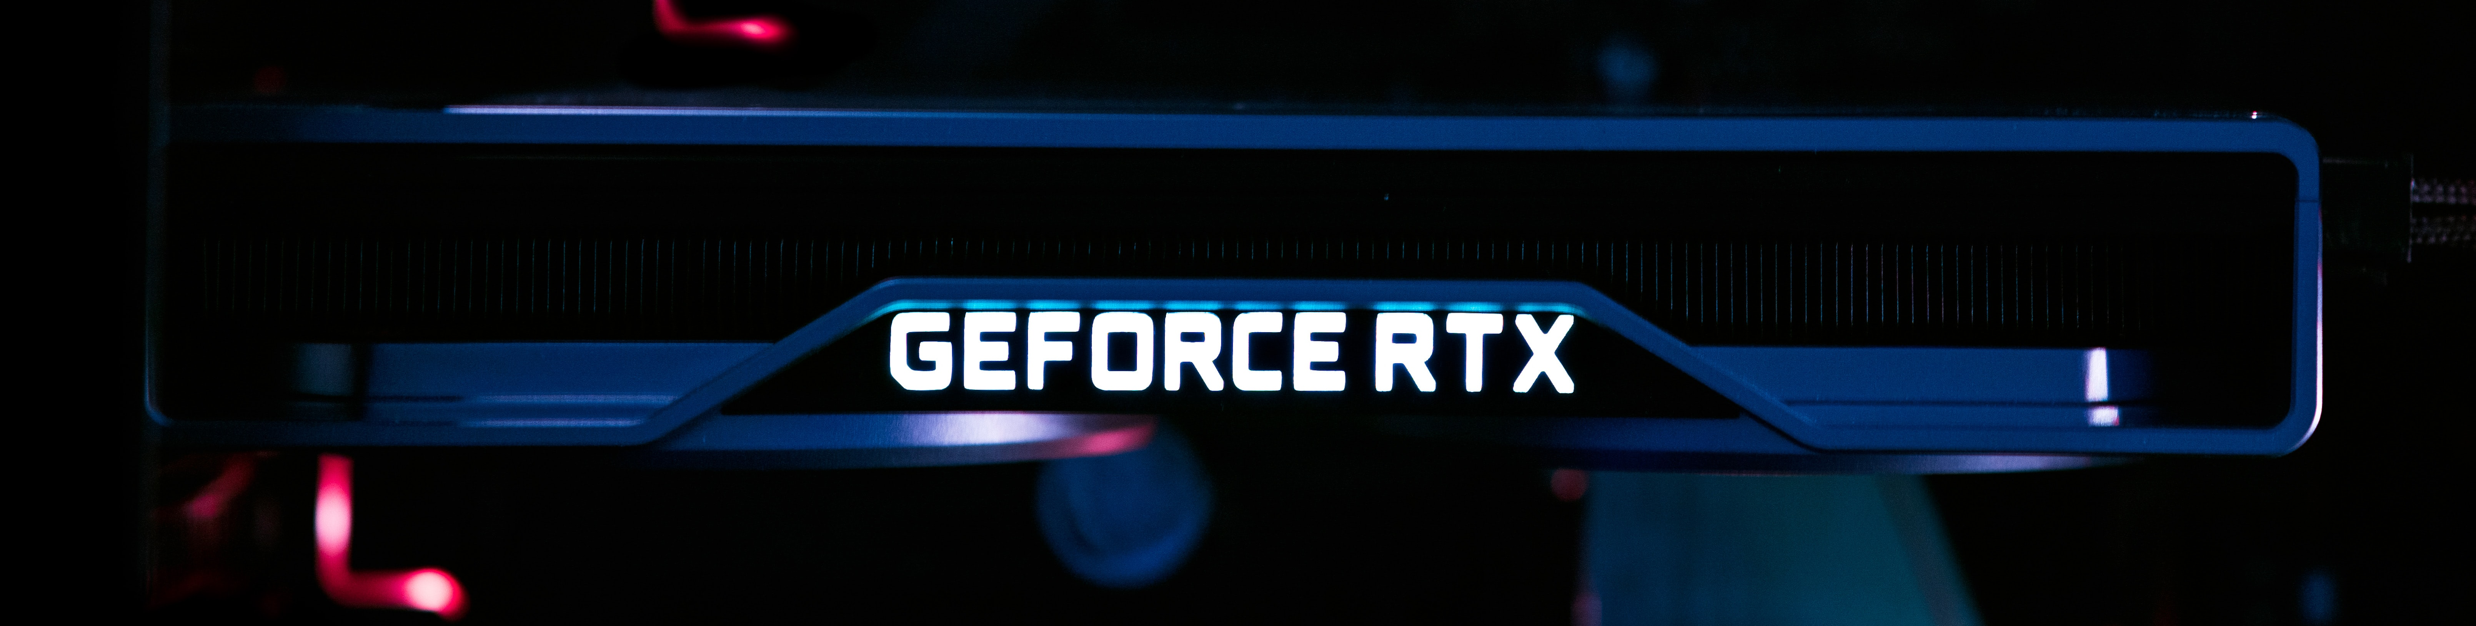
Strong style generator convolution - free
GAN's (Generative Adversarial Networks) models are living a huge success since their introduction in 2014. Nowadays resolution and quality of the generated images increased a lot, despite that, there is something that doesn't changed: the consideration of convolutional backbones as fundamental to achieve high-resolution images and a stable training. In this work, we have tried to implement a strong, and light, style-based generator designed with as a convolution-free structure based on NPL technologies like Transformer and Attention.

Slide 3

tech overview
How GAN works and why we are trying to use NPL technologies to generate images.

Slide 4

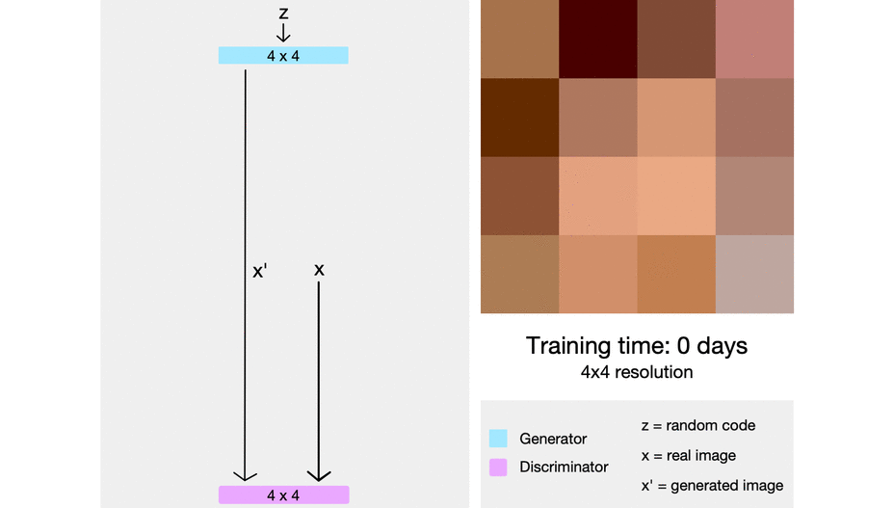
Style
Generative adversarial network
First GAN model was introduced by Ian Goodfellow in 2014.
StyleGAN is a progressive growing GAN architecture, able to synthesizing high resolution and quality images with incremental growing of discriminator and generator.
That model shows some problems in generation, StyleGAN2 addressed most them using skip connection and replacing AdaIN with a statistic-based approach.
Some problem remains, shortcomings derived using a convolutional network such locality problem led to a difficult capture of the global features.

Slide 5
ALL you need is TRANSFORMER
"The first transduction model relying entirely on self-attention to compute representations of its input and output without using sequence-aligned RNNs or convolution“
Designed for NPL, recently is rising as an alternative to convolution operation in the computer vision field.
Based on attention, a mechanism that mimic the cognitive attention focusing on small but significative details of an image, a token or any other significative data.
Stacking attention and combining them with feed-forward layers, we can form encoders (self-attention).

Slide 6
ALL you need is TRANSFORMER
Solves the difficult to capture long-range dependency without stacking multiple layers.
Indeed, using self-attention we are able to capture long-range dependency and understand global features efficiently.
Using Linformer we can address Transformer expensive cost while dealing with high-resolution images.
Notes:
However, drawbacks of CNNs clearly exist. Local receptive
field of CNNs makes model difficult to capture long-range
dependency and understanding global structure of object.
Stacking multiple layers can solve this problem, but
this leads to another problem of losing spatial information
and fine details.
Transformer presents also some drawbacks, indeed, for higher dimension data it results prehibitevely costly since the self attention-mechanism have a cost of O(n^2), for this reason we have used Linformer [4] to overcome this issuse. Linformer reduce the complexity from quadratic to linear by projecting key and value to k dimension while applying self-attention, so that the cost results to be O(nk) with k defined as the projection dimension for key and value.

Slide 7
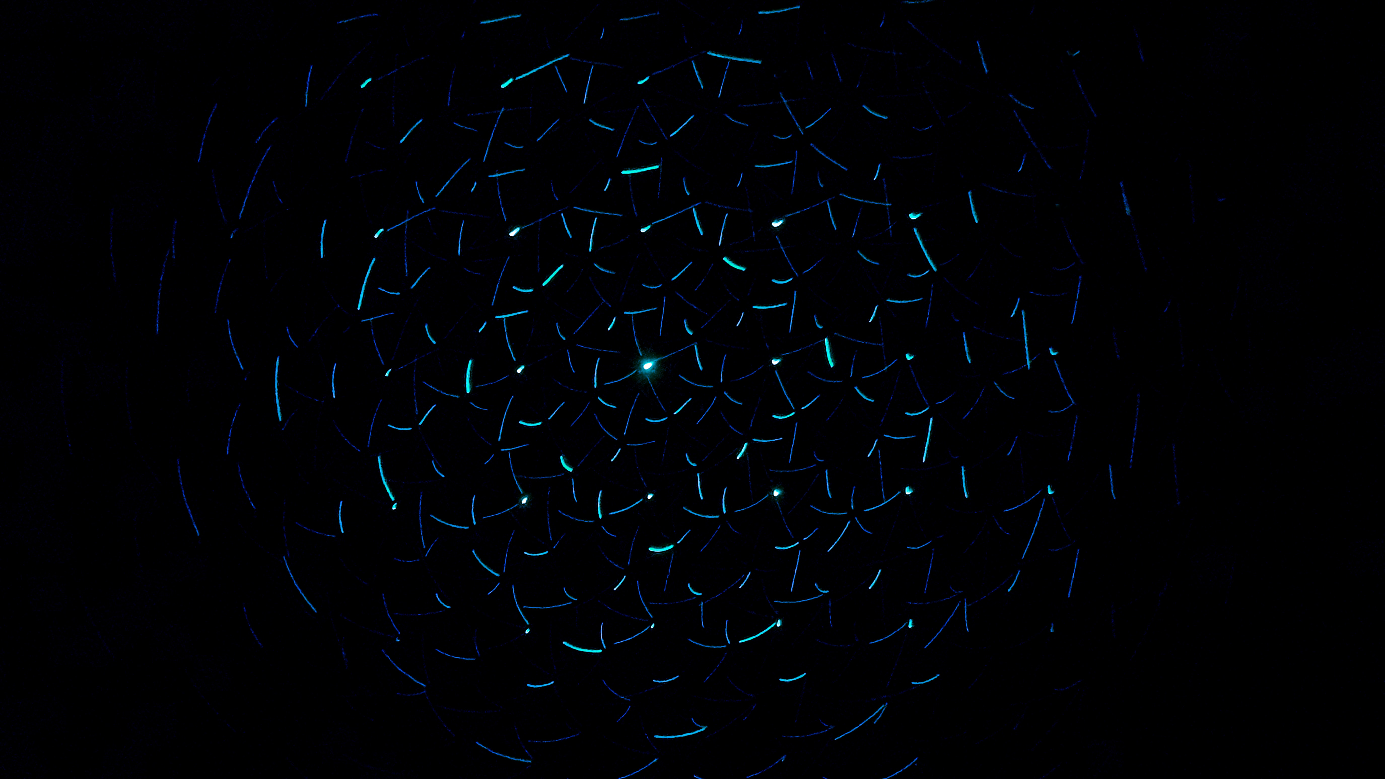
architecture overview
How Styleformer is built, which are the main components and how it works

Slide 8
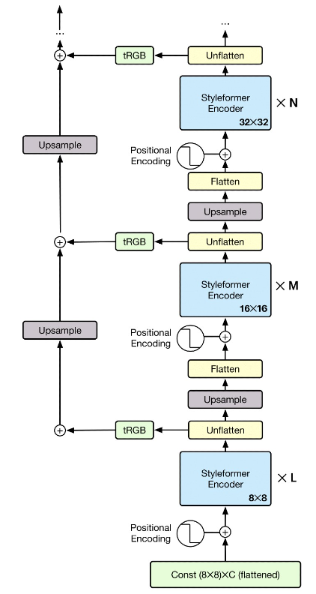
ARCHITECTURE
Styleformer generator is conditioned on a learnable constant input and combined with a learnable positional encoding.
The constant input(8x8) is flattened(64) to enter the Transformer-based encoder, then the Styleformer encoder.
Each resolution passes through several encoder blocks. Bilinear upsample operation. Adding positional encoding.
Repeat until reaches the target image resolution.

Slide 9
Architecture ENCODER BLOCK
We need a Transformer-based generator
We need a style modulation and demodulation methods
Attention mechanism can be seen as built in two steps
preparation module: compute Query, Key and Value
main module: attention operation is applied
Notes:
However, drawbacks of CNNs clearly exist. Local receptive
field of CNNs makes model difficult to capture long-range
dependency and understanding global structure of object.
Stacking multiple layers can solve this problem, but
this leads to another problem of losing spatial information
and fine details.
Transformer presents also some drawbacks, indeed, for higher dimension data it results prehibitevely costly since the self attention-mechanism have a cost of O(n^2), for this reason we have used Linformer [4] to overcome this issuse. Linformer reduce the complexity from quadratic to linear by projecting key and value to k dimension while applying self-attention, so that the cost results to be O(nk) with k defined as the projection dimension for key and value.

Slide 10
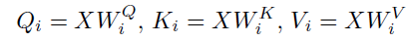
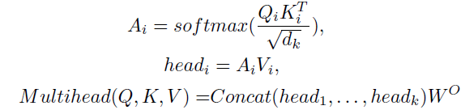
COMPUTING ATTENTION
Preparation module is a module that creates Quey, Key and Value to conduct attention:
Main module is a module that performs attention operation:
Notes:
However, drawbacks of CNNs clearly exist. Local receptive
field of CNNs makes model difficult to capture long-range
dependency and understanding global structure of object.
Stacking multiple layers can solve this problem, but
this leads to another problem of losing spatial information
and fine details.
Transformer presents also some drawbacks, indeed, for higher dimension data it results prehibitevely costly since the self attention-mechanism have a cost of O(n^2), for this reason we have used Linformer [4] to overcome this issuse. Linformer reduce the complexity from quadratic to linear by projecting key and value to k dimension while applying self-attention, so that the cost results to be O(nk) with k defined as the projection dimension for key and value.

Slide 11
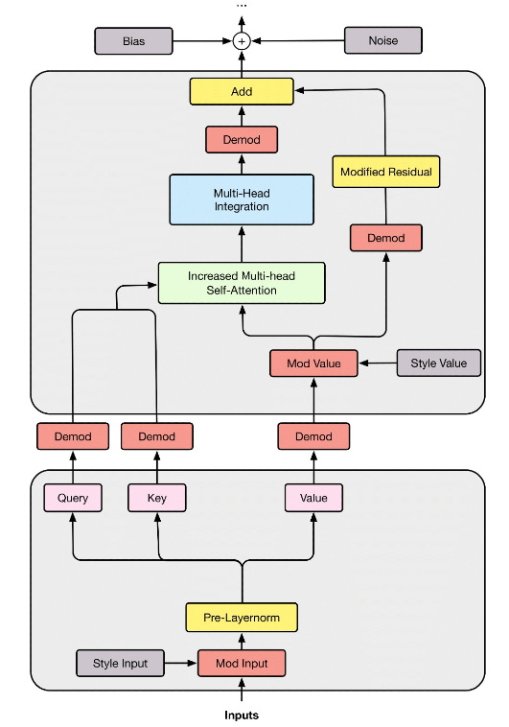
ARCHITECTURE
FOCUS ON ENCODER BLOCK
Pre-Layer Normalization procedure
Demodulation of Query, Key and Value
Core of Self-Attention: production of the attention map and the weighted sum of V with attention map itself
Increased the number of head of multi-head attention the created attention map will be different for each head
Further demodulation
Add bias and noise at end of each blocks

Slide 12
Conclusions
How good STYLEFORM is?
CIFAR-10 is widely used as a benchmark dataset. They used 50K images(32x32) at the training set, without using label.
We have used two of the most known metrics for image evaluation:
Fréchet Inception Distance, known as FID, is a method for comparing the statistics of two distributions by computing the distance between them
Inception score, known as IS, is a popular metric for judging the image outputs of GAN which measure of how realistic a GAN’s output is.
CIFAR-10 | FID | IS
PROGRESSIVE GAN | 15.52 | 8.80
Transgan | 9.26 | 9.02
Stylegan2 | 2.92 | 9.83
styleformer | 2.82 | 10.0

Slide 13

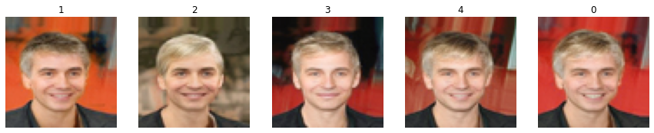
Conclusions
WHAT WE EXPERIMENTED ON COLAB?
Training and image generation.
Assembling a custom and topic-based dataset to train on it.
Assembling generate images to achieve a morph effect.
Exploring latent vectors direction performing fine tune.

Slide 14

Conclusions
WHAT’S NEXT?
Test Styleformer with high end resources to have better train results in less time.
Reduce the computational cost to test with higher-resolution images.
Redesign also the discriminator to use Transformer.
Porting this project to Stylegan3.

Slide 15




Thank you!
Styleformer Implementation
Google Colab Notebook
Fabio Caputo
Weihao Peng

